Slide 1
Spring Framework

Slide 2
What is framework?
Predefined API which can be embed in programs.
Makes fast application development

Slide 3
Why Java Framework?
So much of code?
How to remember everything?
How to complete projects in time limitations?
Requirements?
Need something that is fast and efficient
That can be fit in all types of codes
Solution?
Yes you can use Java Frameworks

Slide 4
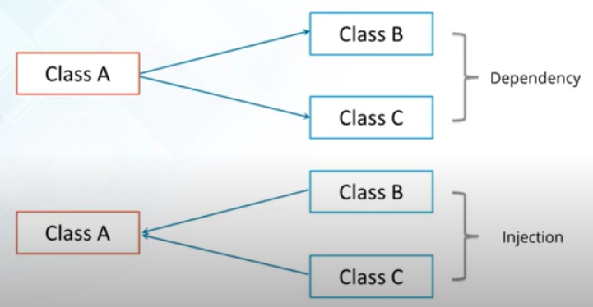
Java Framework Principle

Slide 5
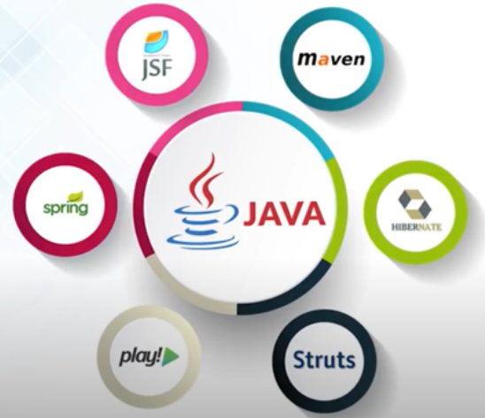
Different Java Frameworks

Slide 6
Spring Origin
First version of spring was released on February 2003 by Rod Johnson
Sprint has been hosted on SourceForge since February 2003

Slide 7
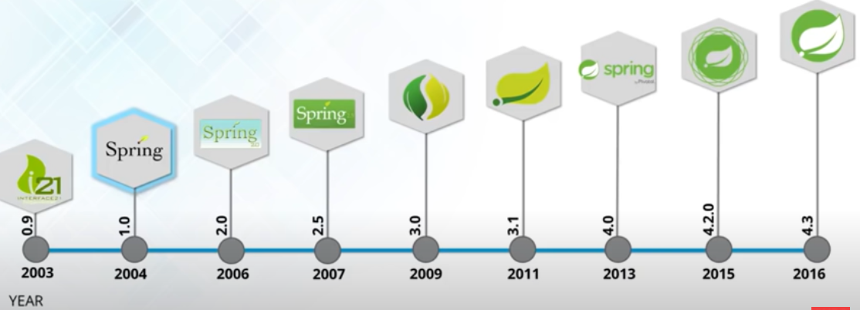
Spring Versions
Now, 5.2 version is running on

Slide 8
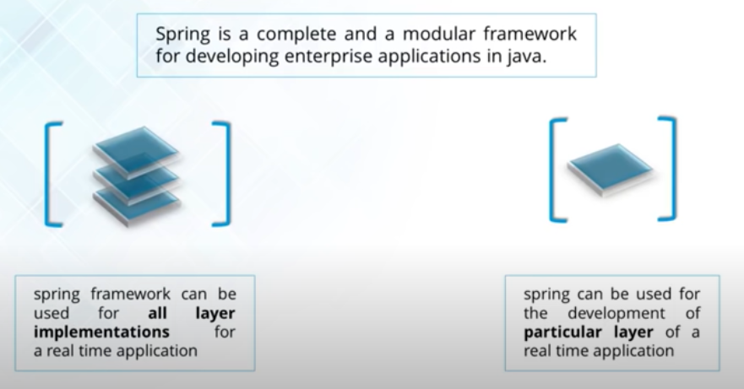
Spring Definition

Slide 9
Spring Features
Open Source
Comprehensive Tools
Light Weight
Solve Problems
Framework of Frameworks
Avails array of resources

Slide 10
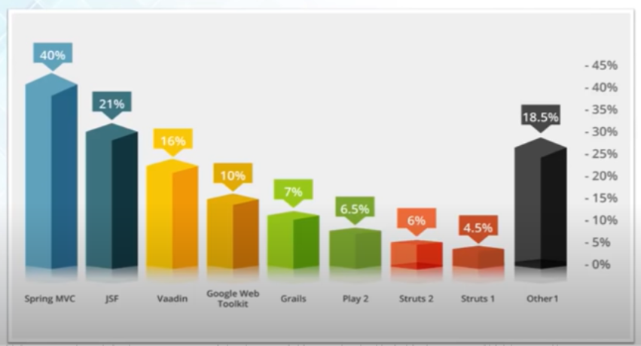
Use of Spring in Industries

Slide 11
Why Spring is So Popular
Just because of 3 reasons:
Simplicity
Testability
Loose Coupling

Slide 12
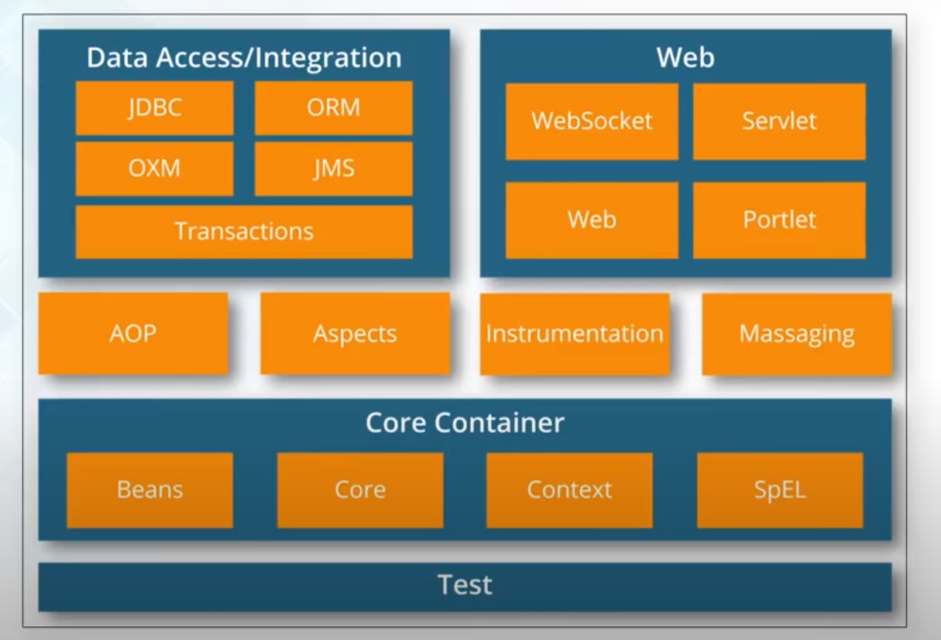
Spring Architecture

Slide 13
Spring Modules
Spring have 20 modules that can be grouped together based on their primary features as following:
Core Container
Data Access /Integration
Web
AOP (Aspect Oriented Programming)
Instrumentation
Test

Slide 14
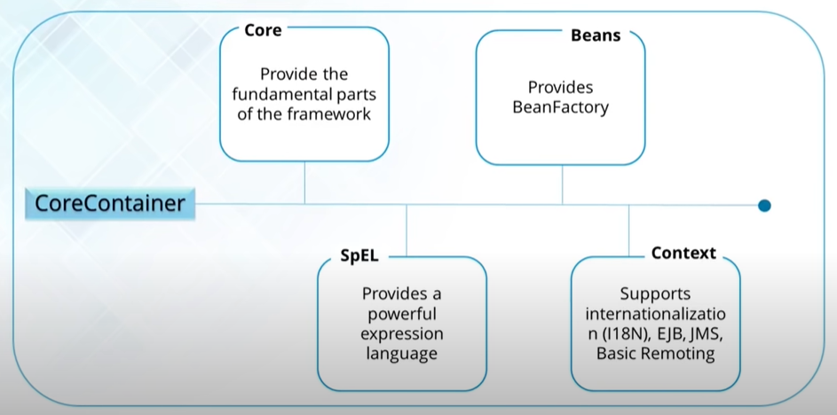
Spring Core-Container

Slide 15
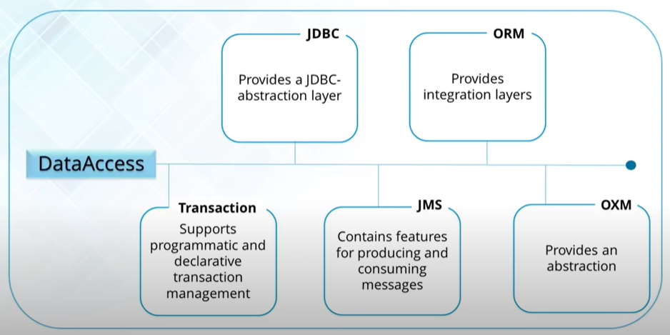
Spring Data Access

Slide 16
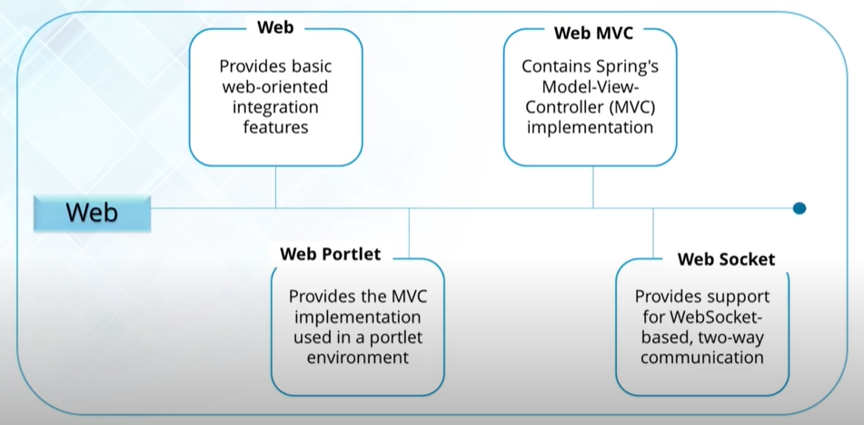
Spring Web

Slide 17
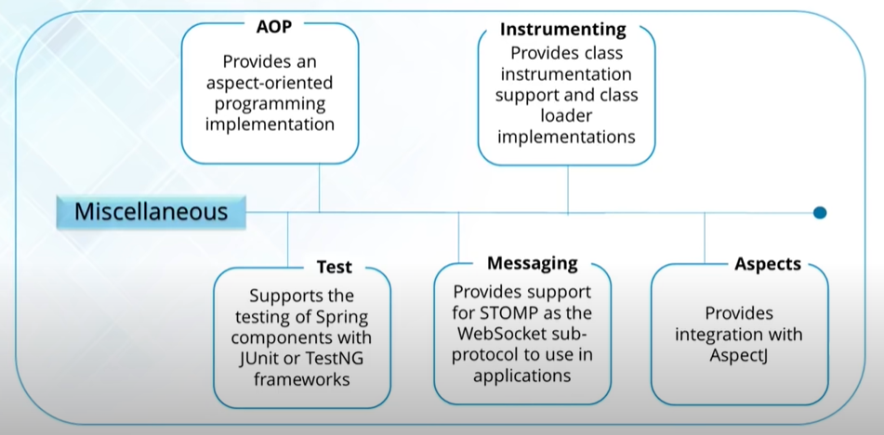
Spring Miscellaneous

Slide 18
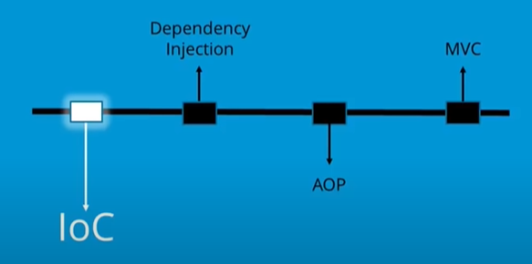
Spring Components

Slide 19
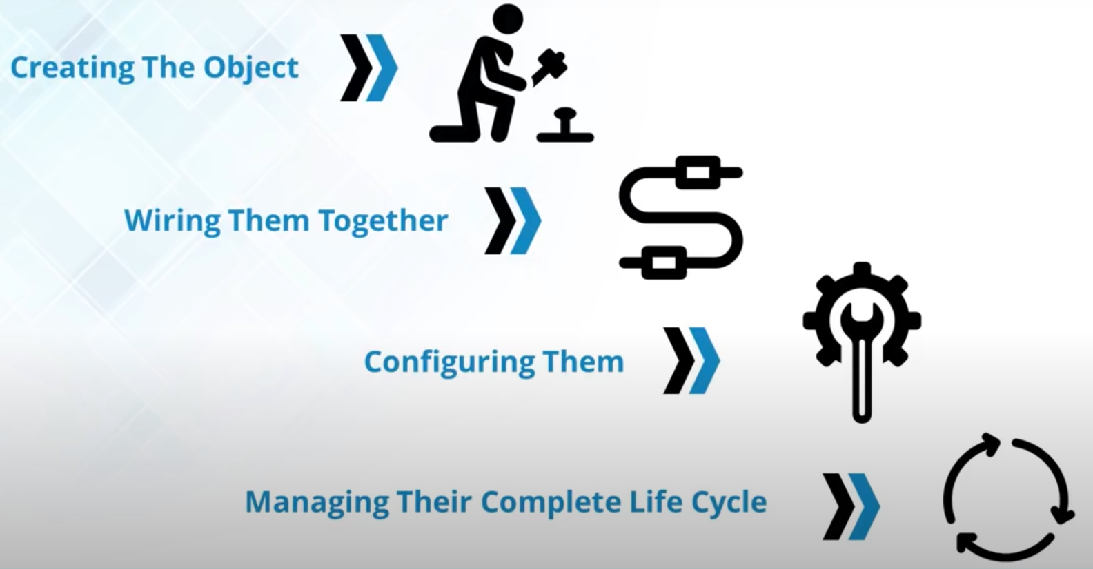
Spring IOC (Inversion of Control)

Slide 20
Types of IOC (Inversion of Control) Container
BeanFactory: Create objects when requested
ApplicationContext: Create objects automatically

Slide 21
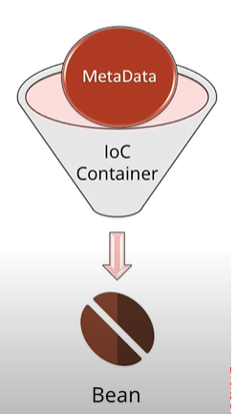
Bean Object
Beans are the objects that form the backbone of our application and are managed by the Spring IoC container
Spring IoC container instantiates, assembles, and manages the bean object.
The configuration metadata that are supplied to the container are used to create beans object

Slide 22
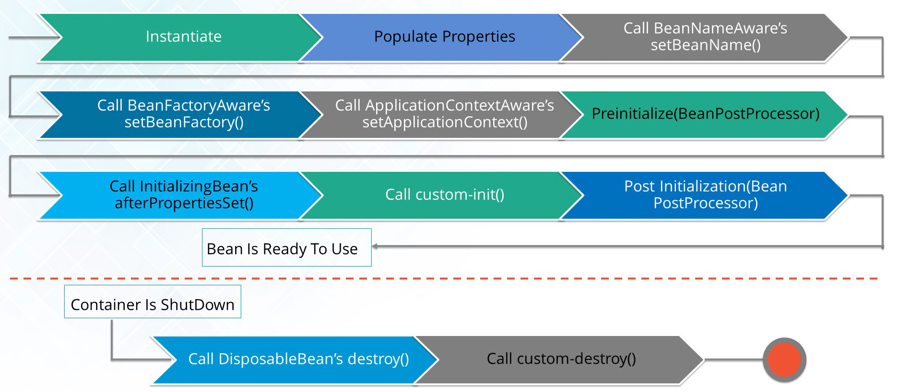
Bean Life Cycle

Slide 23
Dependency Injection
It is design pattern which removes the dependency from the programming code, that makes the application easy to manage and test.
Dependency Injection make sour programing code loosely coupled, which mean change in implementation does not affects the user.

Slide 24
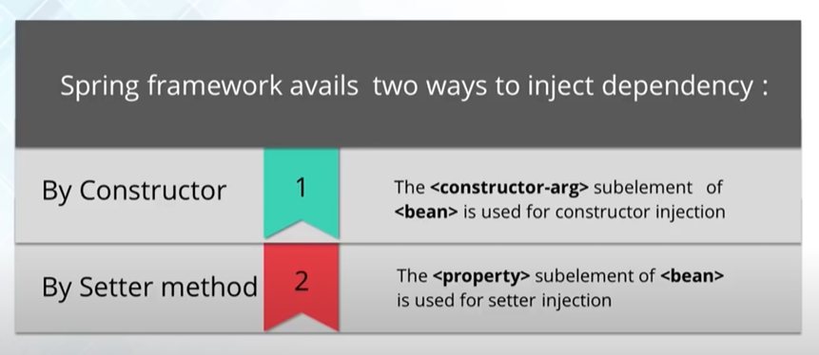
Types of Dependency Injection

Slide 25
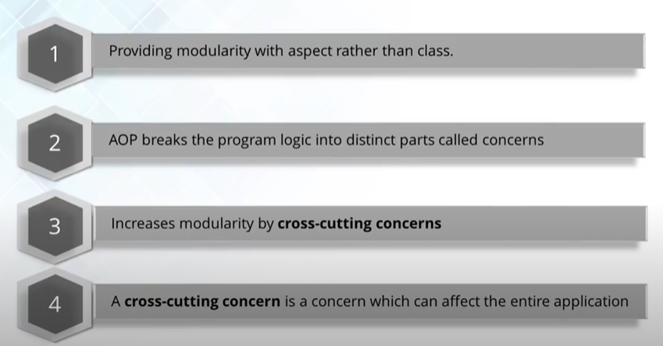
AOP (Aspect Oriented Programming)

Slide 26
Why AOP (Aspect Oriented Programming)?
It provides pluggable way to dynamically add the additional concern before, after and around the actual logic.

Slide 27
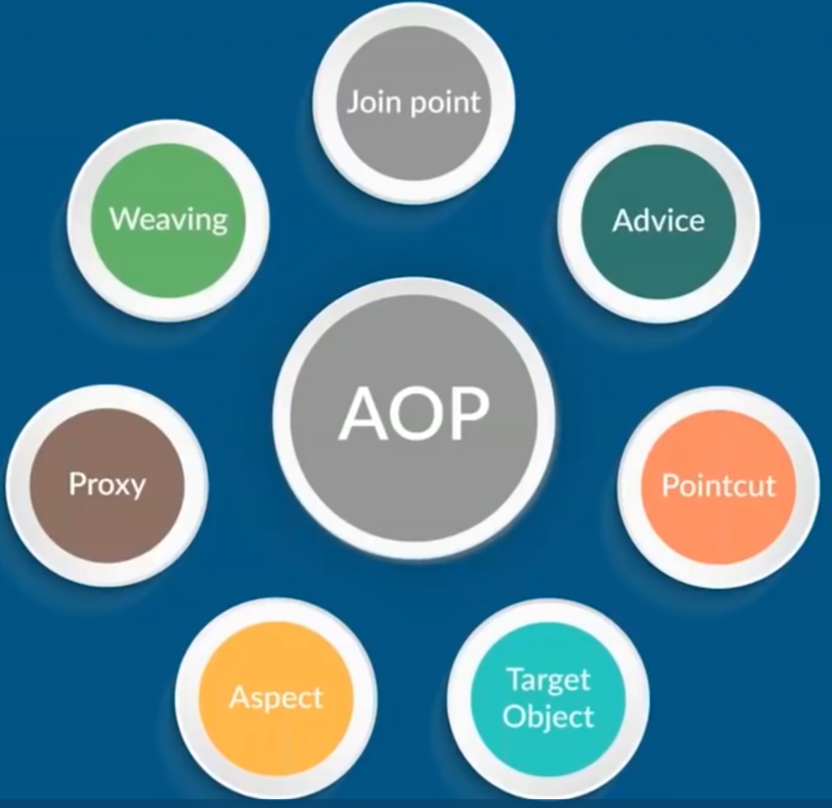
AOP Core Concepts

Slide 28
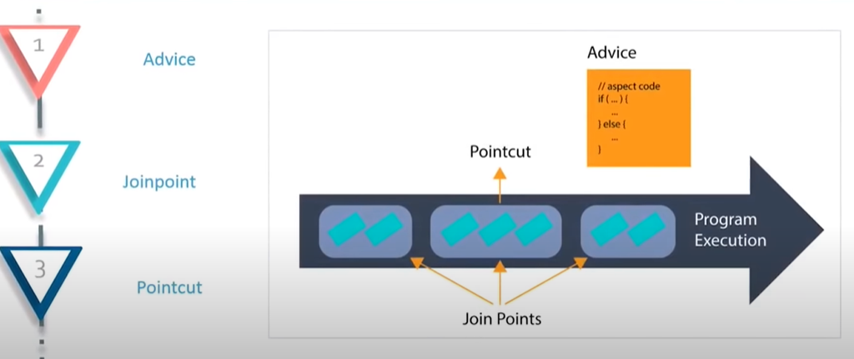
AOP Core Concepts

Slide 29
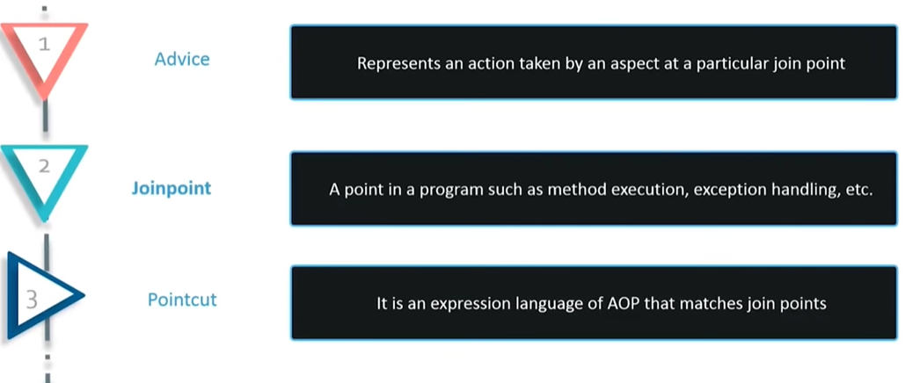
AOP Core Concepts

Slide 30
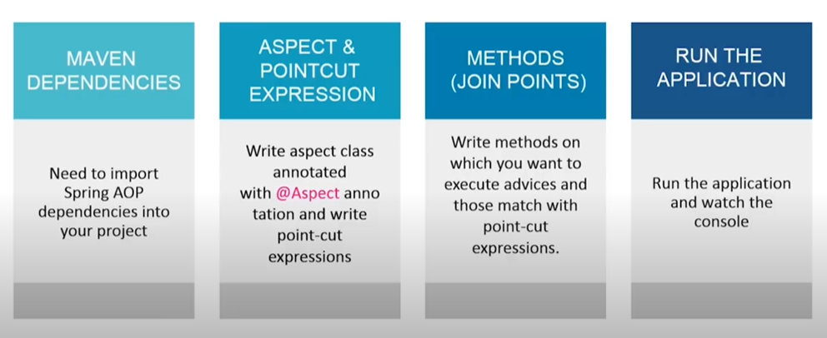
AOP Example

Slide 31
Bean Scopes
When the Spring Framework creates a bean, it associates a scope with the bean. A scope defines the runtime context within which the bean instance is available.
In Spring, a bean can be associated with the following scopes:
Singleton
Prototype
Request
Session
WebSocket
Application

Slide 32
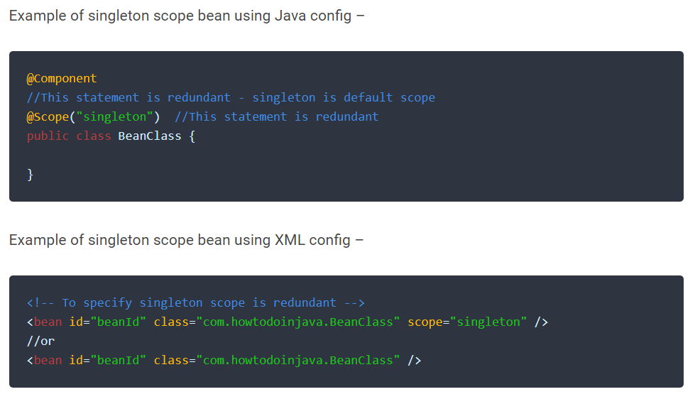
Singleton Bean Scopes
It is default one
Single bean object instance per spring IoC container

Slide 33
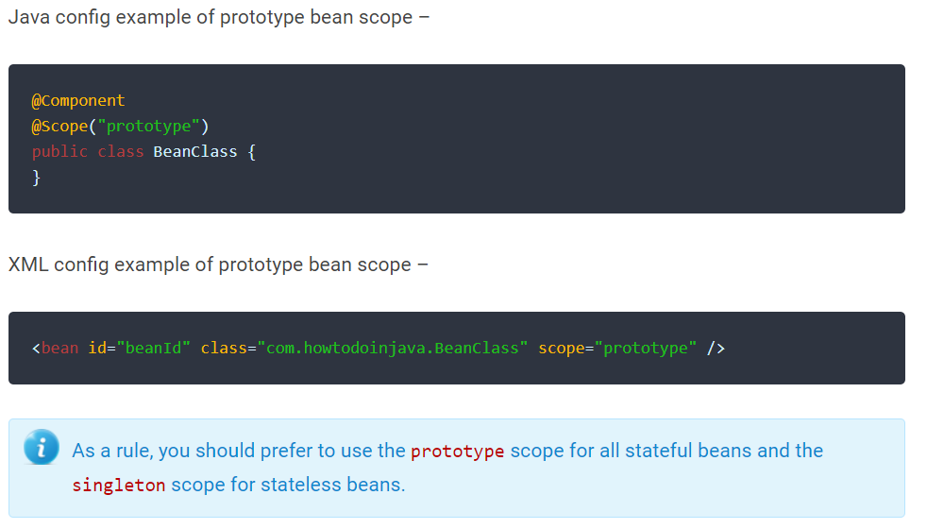
Prototype Bean Scopes
Opposite to singleton, it produces a new instance each and every time a bean is requested.

Slide 34
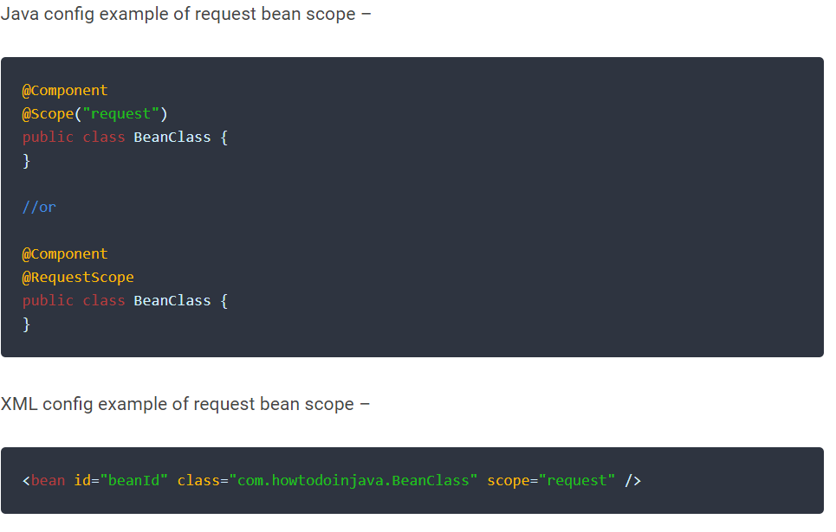
Request Bean Scopes
A single instance will be created and available during complete lifecycle of an HTTP request.
Only valid in web-aware Spring ApplicationContext.

Slide 35

Session Bean Scopes
A single instance will be created and available during complete lifecycle of an HTTP Session.
Only valid in web-aware Spring ApplicationContext..

Slide 36
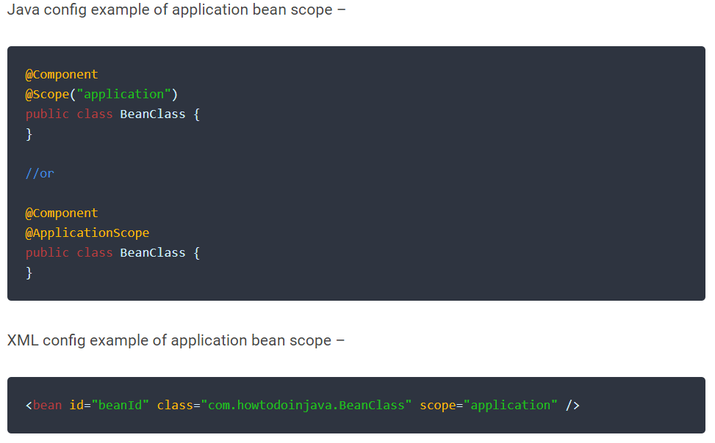
Application Bean Scopes
A single instance will be created and available during complete lifecycle of ServletContext.
Only valid in web-aware Spring ApplicationContext.

Slide 37
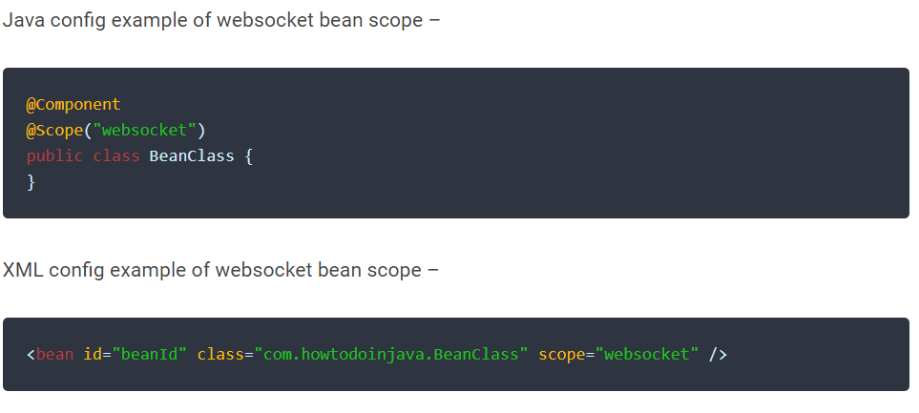
WebSocket Bean Scopes
A single instance will be created and available during complete lifecycle of WebSocket.
Only valid in web-aware Spring ApplicationContext.

